Slide 1
CAPSTONE PROJECT –
DVD RENTAL DATABASE

Slide 2
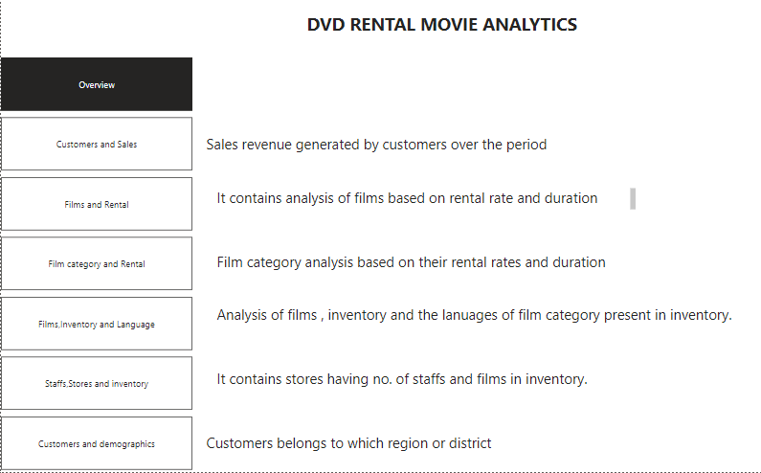

Slide 3

DVD RENTAL ANALYTICS
The DVD Rentalanalysis is A data analysis project that uses the northwind dataset, A sample database that contains data about store that sells rental dvd around the world.
The DVD Rental dataset offers comprehensive insights into various aspects of the business, focusing on customer analysis, films and rental analysis, staff and stores analysis,inventory analysis.

Slide 4
DVD RENTAL ANALYTICS
What are the most profitable films,film category .Which category of films liked by customers.Customers analysis based on sales.
How do the customers of stores differ in their preferences, behavior, and loyalty, and how can they segment and target them effectively?
How can store optimize their inventory management, and delivery quality, and how can they forecast their demand and supply?

Slide 5
Approach
Import and Explore the RENTALDatabase Using Power Bi
Create and Test Hypotheses Using SQL Queries
Visualize and Interpret the Results Using Excel
Discuss the Implications and Recommendations for RENTAL STORES

Slide 6
The project will involve the following tasks
Conducting a thorough analysis of the customer behavior, preferences, using EXCEL, Power BI and sql.
Drawing meaningful conclusions and recommendations for stores
How to imrove their sales,manage inventory.
The success of the project will be measured by the following metrics:
The accuracy of the analysis
The usefulness of the insights
The effectiveness of the recommendations
This project is significant because it has the potential to improve the sales of store based on the insights.Be more profitable in coming days

Slide 7
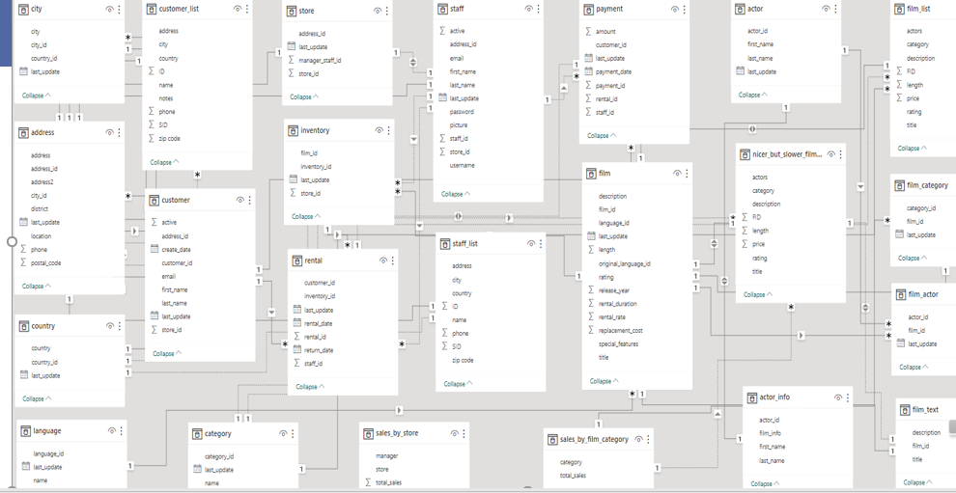
ER DIAGRAM

Slide 8

Power Bi Report

Slide 9
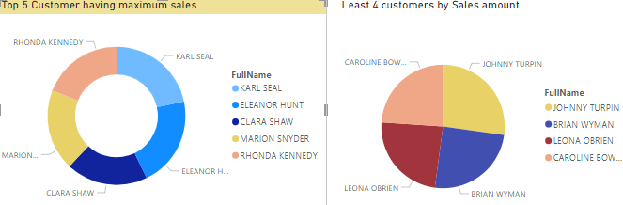
How does customer distribution vary with its sales revenue? The pie chart shows the customer with the highest sales and the customers with the lowest sales

Slide 10
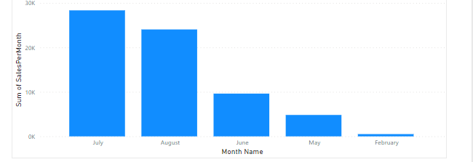
How the sales revenue of customers varies in certain months? Analysis shows in July month we have the highest sales and in feburary month we have least sales among the five months present in table.

Slide 11
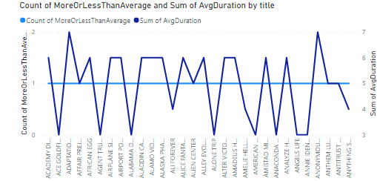
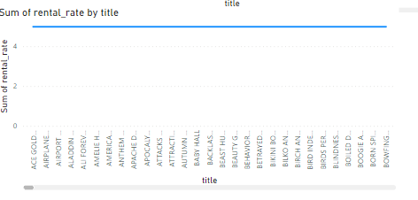
Analyse the films with avg rental duration and more than average rental duration? Analysis of films having more than avg.rental duration and less than avg.rental duration. Analysis of films having avg rental rate.we basically three types 4.99, 2.99 and 0.99

Slide 12
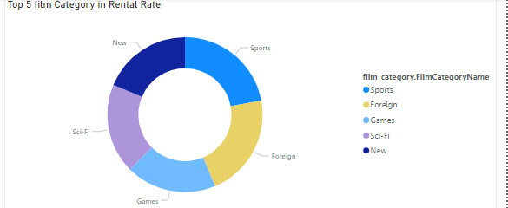
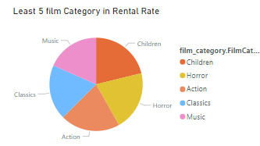
Analysis of top 5 films based on their category.
Sports is most popular category
Analysis of least 5 films based on category
We can say Music is lowest in terms of sales revenue.

Slide 13
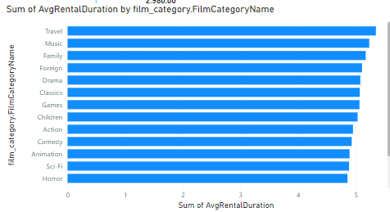
Analysis of film category based on
Rental duration.
In this Travel category has most Rental
Duration.

Slide 14
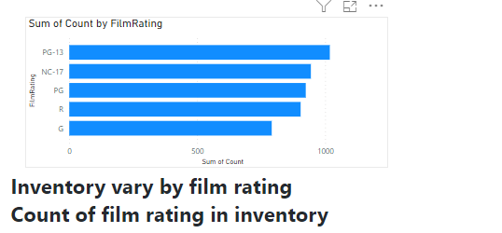
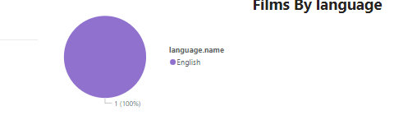
As we can see that we count of film rating in inventory.PG-13 rating films and least is G rating
After analysis we have only English language movie in inventory.

Slide 15
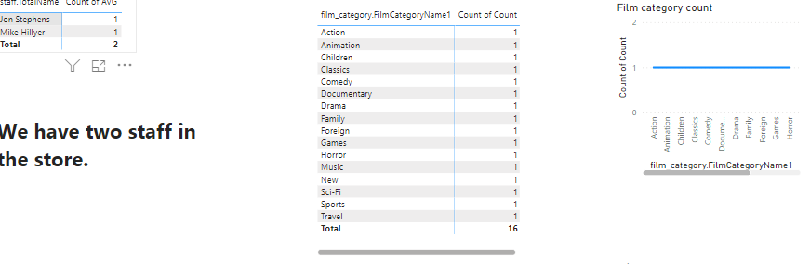
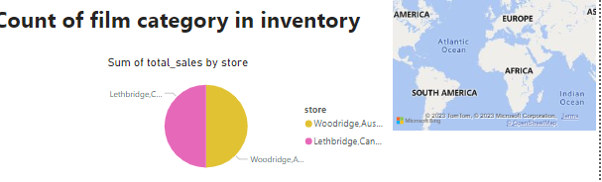
We have only two staff in store and 16 categoryfilm is present in the inventory.
We have only two store and which is located in Canada and London.
Have almost equal amount of sale.

Slide 16
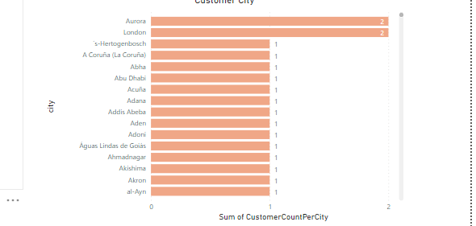
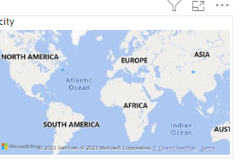
Distribution of customers across different cities
We have customers from different cities but London and aurora we have 2 customers .Rest we have only one customer.

Slide 17
EDA Report

Slide 18
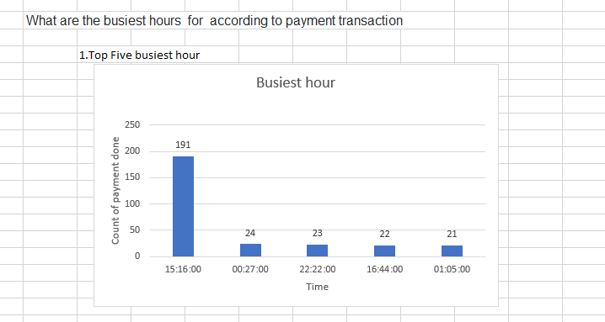
Here we can see the analysis of the
Busiest hour of stores in terms
Of payment and it is the representation
Of top 5 busiest hour.
So we can say most no. of people
Are present at 15:16:00

Slide 19
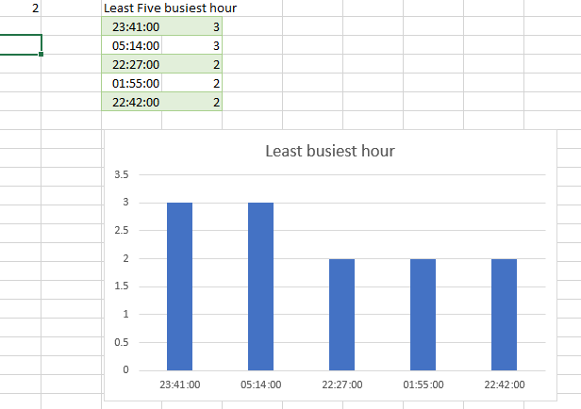
Here we can see the analysis of the
Least busiest hour of stores in terms
Of payment and it is the representation
Of least 5 busiest hour.
So we can say less no. of people
Are present at 22:42:00

Slide 20
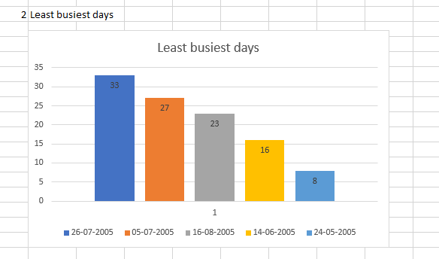
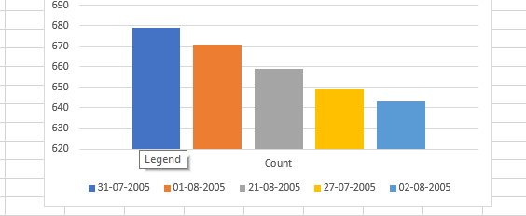
After analyzing the more busiest date is 26th July 2005 and leat is 02august 2005
In terms of count of customers payment

Slide 21
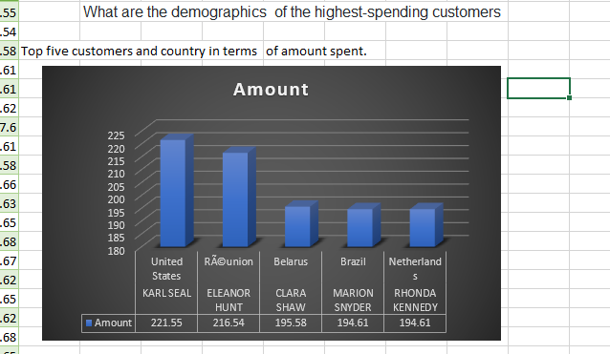
Analysis of top 5 customers and country based on their sales
.
United states has the highest number
Of sales among their customers.

Slide 22
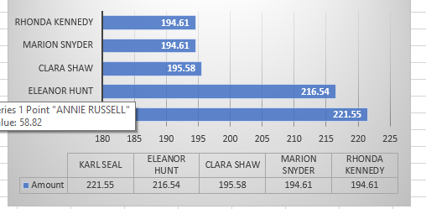
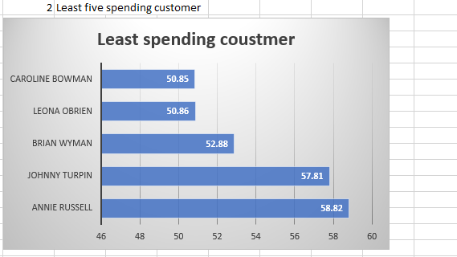
Analysing the customers based on their spending
Rhonda kennedy has the highest no. of
Spending.
For lowest we have caroline Bowman.

Slide 23
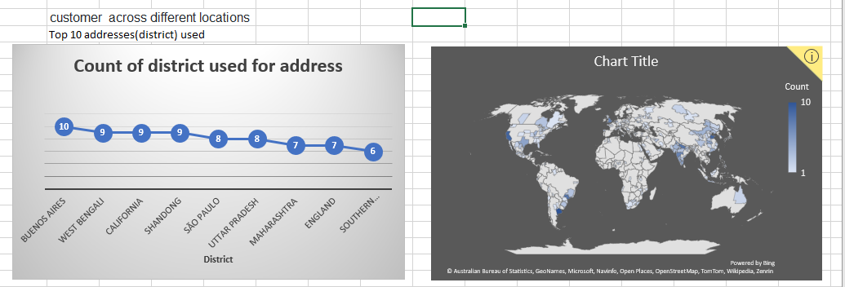
We have customers frpm different locations and which district is used for address
For most no. of times is BUENOS AIRES.

Slide 24
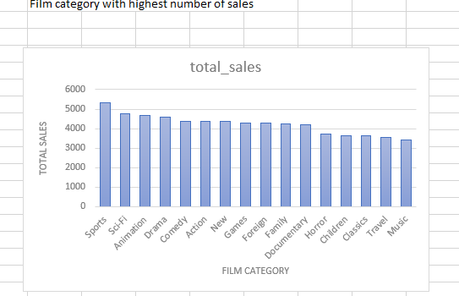
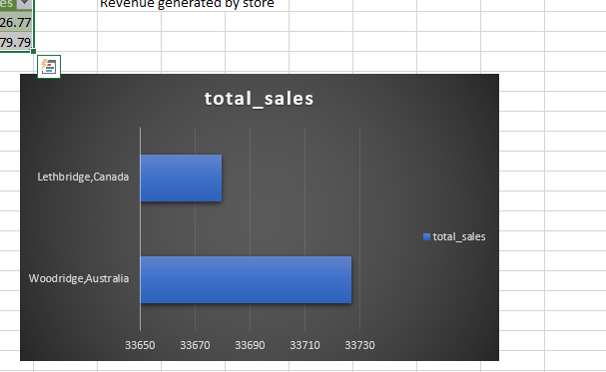
Sports category films has highest no. of sales and most
Popular in stores and least in music.
We have two stores and total sales by each store is represented in the following graph.

Slide 25
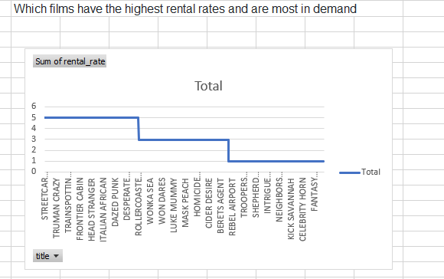
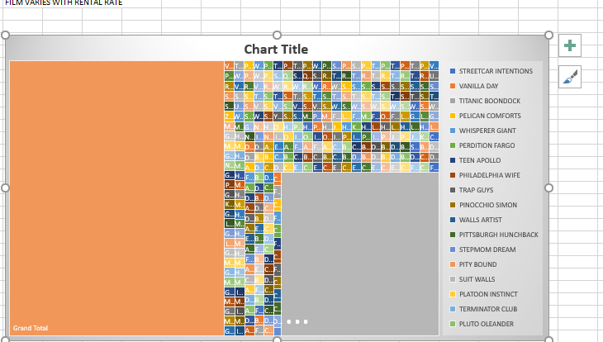
Analysis of highest rental films and count of the films having the highest rental rates.
Box plot for the highest rental rate films.

Slide 26
SAME CASE ANALYSIS WITH SQL

Slide 27
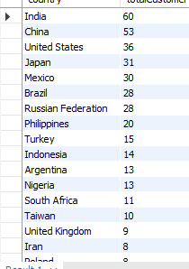
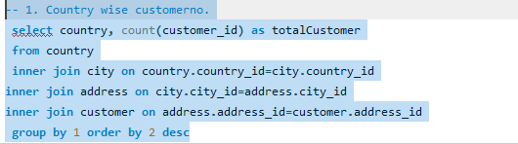
-- 1. Country wise customerno.

Slide 28
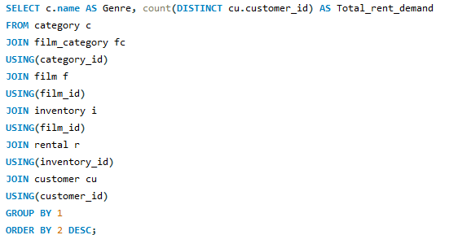
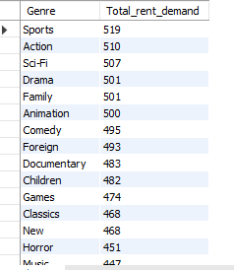
2.Can we know how many distinct users have rented each genre?

Slide 29
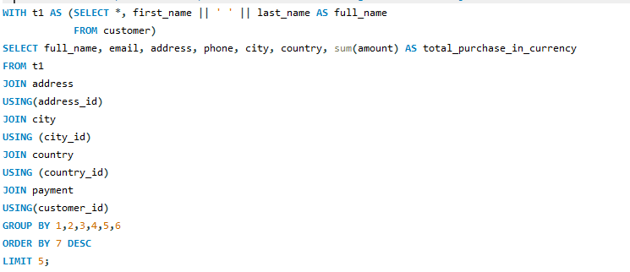
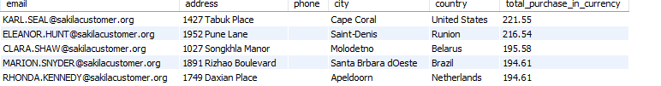
3. Who are the top 5 customers per total sales and can we get their detail just in case Rent A Film want to reward them?

